Slide 1
Which factors influence life expectancy the most (positively and negatively)?
Data taken from The Global Health Observatory (GHO) data repository under World Health Organization (WHO)(from Kaggle.com): 2000-2015

Slide 2
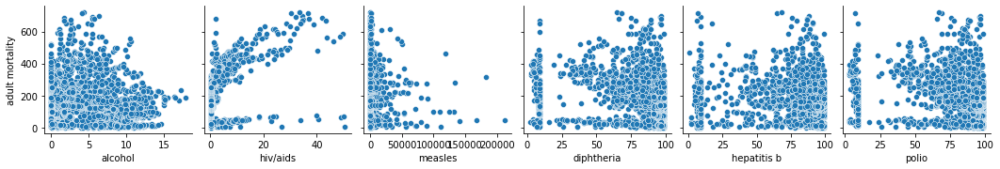
How do diseases affect adult mortality?
Summary: Data was not even and couldn’t see clear connections.So we decided to split data set into two groups developed and developing countries with just three features.

Slide 3
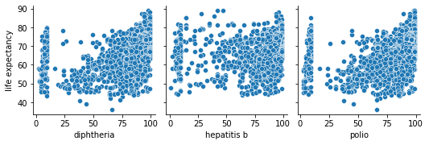
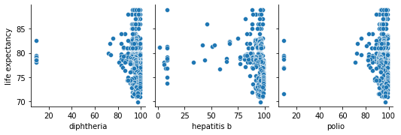
Immunization developed vs. developing countries
Summary: Imunization is better in developed than developing countries. So life expectancy in developed countries not changing depending on imuniztion.

Slide 4
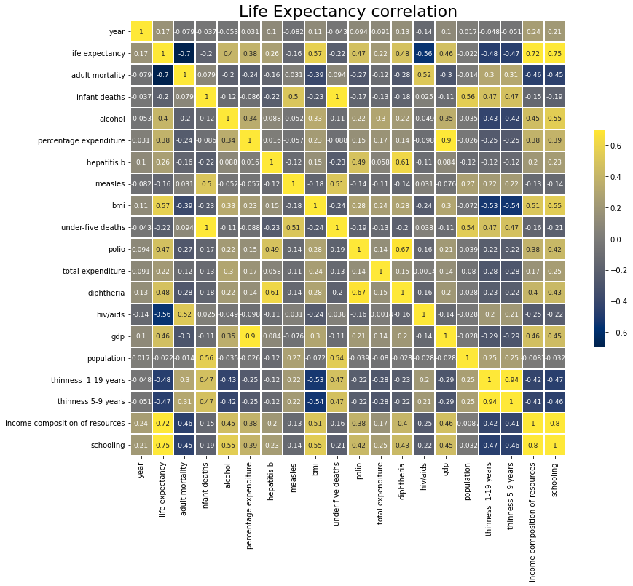
Summary: we made a matrix and chosen those features which we think made the most influense for life expectancy. Following features:
Income composition of resources
BMI
Schooling
GDP

Slide 5
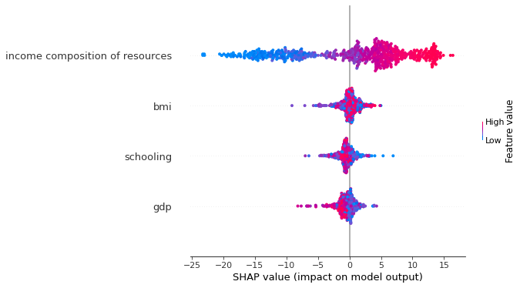
SHAP
Human Development Index in terms of income composition of resources (index ranging from 0 to 1)
Average Body Mass Index of entire population
Number of years of Schooling(years)
Gross Domestic Product per capita (in USD)

Slide 6
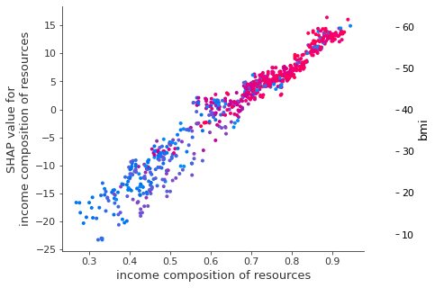
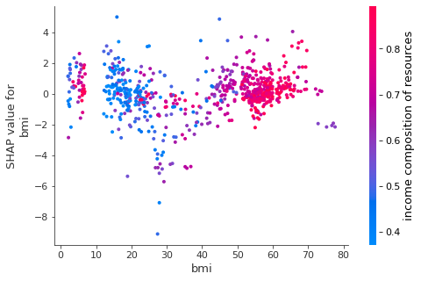
Comparing income composition of resources vs. BMI

Slide 7
Conclusion of analysis:
High imunization and low diseases level increase life expectancy;
SHAP metod showed us that income composition of recources make a most impact into life expectancy and BMI;

